Slide 1
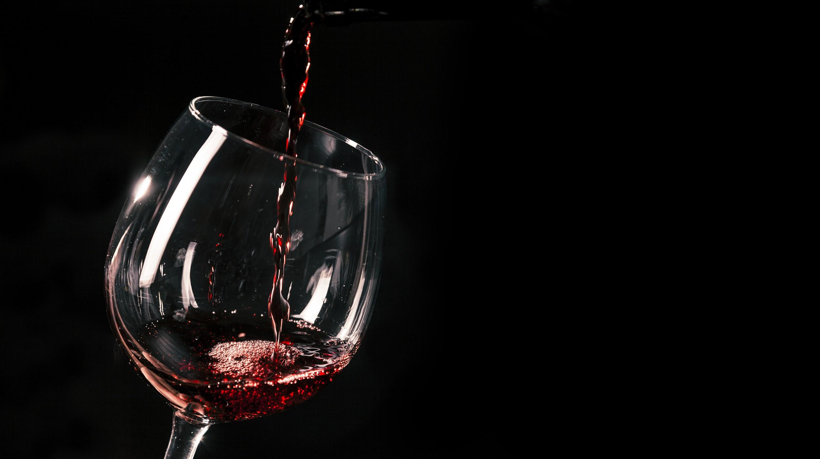
THE CHIANTI WINE REGION OF ITALY

Slide 2
INTRODUCTION
Chianti is a wine production region in the mountainous region of Tuscany, central Italy.
The region is spread across the Italian provinces of Pisa, Pistoia, Arezzo, Siena, Florence and Prato.
Due to its closeness to Florence, the region is a popular tourist destination, especially for wine lovers. The region is known for its rich food and art history, hot summers and sweeping landscapes.
The rationale for choosing Chianti for my presentation was that recently, Italy has been challenging France’s position on wine lists and customer preferences. I am also fascinated by Chianti’s unique bottles, which bear a black rooster.
Given the rich history of Tuscany, I am also quite sure the history of wine production on Tuscany is just as rich. I think it is worth to explore Chianti’s wine.

Slide 3
HISTORY/OVERVIEW
Chianti as a region first appeared in the 13th century. At the time, Chianti was used to describe an area near three villages; Castellina, Gaiole and Radda.These three later came to be the Provincia del Chianti or Chianti province.
At the time, Chianti was a geographical district rather than a wine region. Chianti’s first reference as a wine area was made around 1716.
This reference was actually the first of its kind; Chianti was the first officially demarcated wine region in the world.
This edict was made by the Grand Duke of Tuscany at the time, Cosimo III..

Slide 4
HISTORY/OVERVIEW
The edict also delimited the Chianti area as territory around Castellina, Gaiole, Radda, Panzano and Greve.
Not much is known about the composition of Chianti wine in this period.
There is evidence that the red wine of this period was mostly made up of the canaiolo grape.
Baron Bettino Ricasoli, the second Prime Minister of Italy is responsible for contemporary-style Chianti as it is known today.
In 1872, the baron dictated that the red blend of Chianti should mostly consist if sangiovese because of its vigour and bouquet and canaiolo should be added to soften the wine.

Slide 5
HISTORY/OVERVIEW
The statesman based this on a synthesis of years of experimentation.
For wines meant for early consumption, the addition of malvasia grape was allowed. This was however discouraged for wines meant for cellaring.
The composition of the Ricasoli wine was as follows; 70% Sangiovese, 15% Canaiolo, 10% Malvasia and Trebbiano and 5% complementary vines such as Colorino and Mammolo.
The Ricasoli blend was an immediate hit to the extent that the Chianti came in first place at an international Paris exhibition in 1878 (Wine and Other Stories, 2020).

Slide 6
HISTORY/OVERVIEW
In 1924, the Chianto Classico Consortium was created to lookout for the misappropriation of the Chianti heritage and production of counterfeits.
The aim of the consortium was to “protect, oversee and valorise the Chianti Classico denomination“.
The effigy of the consortium was a black rooster. This rooster can still be found on bottles made by the consortium’s members (Wine and Travel Italy, 2021).
The Consortium was also the first to officially define “Chianti Classico” and its members were allowed to use the term as a means of differentiating their products. Till date, the Consortium strives to differentiate the “Classico” from generic Chianti.

Slide 7
HISTORY/OVERVIEW
It is also important to note that the Consortium has faced various challenges since its establishment.
Their interests collided with those of the mass producers and big exporters. The Italian Parliament failed to support the consortium’s effort to define the Chianti Classico zone.
In fact, what happened was that the Dalmasso Commission of 1932 expanded the Chianti Classico zone. Six Chianti sub-zones were added.
In addition to the Chianti Classico, the Commission defined Chianti Montalbano, Chianti Colli Senesi, Chianti Colli Aretini, Chianti Rufina, Chianti Colli Fiorentini and Chianti Montespertolli.
This division failed to consider mesoclimate and terroir, which are common viticultural aspects. This leads us to our discussion, the terroir.

Slide 8
TERROIR
Terroir refers to the sense of place in a wine.
It is a combination of human and natural factors. Human factors include production choices such as winemaking techniques and viticulture while natural factors include; topography, soil, climate and grape variety and clone.
In the Chianti Classico subregion, the geography and soil is quite varied and altitude ranges from 820 to 2000 feet with rolling hills resulting in different macroclimates. In the area, there are 2 main soil types; alberese, a weathered sandstone and galestro, a grey marlstone (Domine, 2008).
In the greater Chinati region, the Rufina subzone has predominantly chalk and marl vineyard soils. The vineyards are elevated causing a cool climate. In the Colli Fiorentini, there are many foreign winemakers rather than traditional ones.

Slide 9
REGULATIONS AND APPELATIONS
Due to a decline in wine quality because of the regulations of the Chianti DOC, Chianti became a DOCG in 1984.
The Chianto DOCG which applies to all subzones apart from Chianti Classico specifies that the wine must contain at least 70% Sangiovese.
Producers may add a label containing the name of the sub-zone if the grapes are exclusively grown in a specific subzone.
Wines may also be classified into two; Chianti Superiore, which is made from grapes of lower-yielding vineyards and Chianti Riserva, which is aged for at least 2 years.
The Chianti Classico has its own DOCG. Its wines are to contain at least 80% Sangiovese and its bottles should be branded with the black rooster.

Slide 10
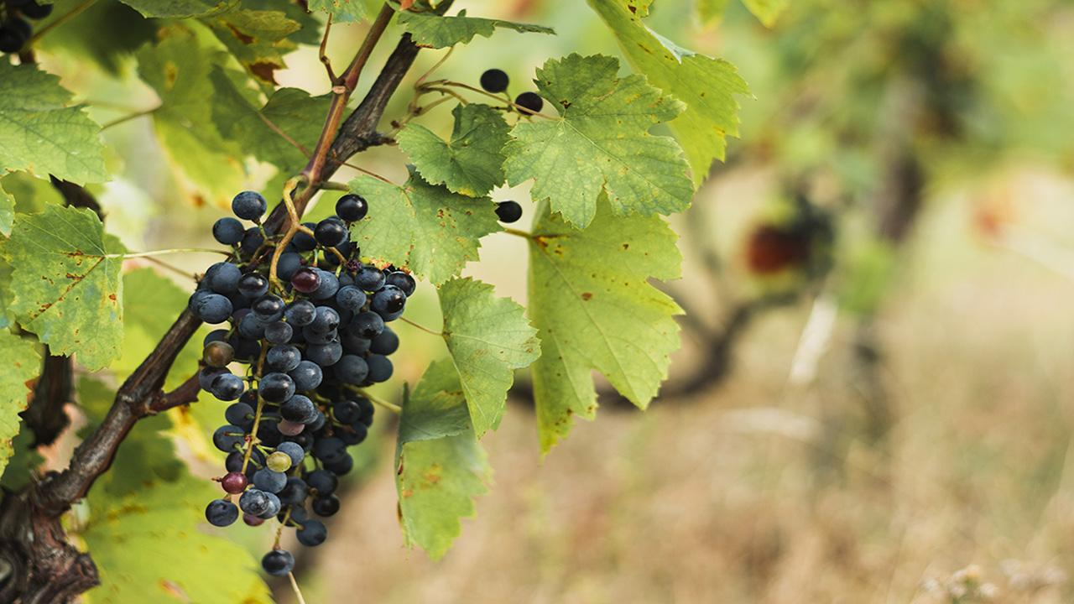
PRINCIPLE GRAPES
Both the Chianti and Chianti Classico have been using 75–100% Sangiovese and up to 10% Canaiolo and up to 20% of any other approved red grape variety such as Cabernet Sauvignon, Merlot or Syrah since 1996.
The Chianti Classico prohibited the use of white grape varieties such as Malvasia and Trebbiano in its wine in 2006 (Mower, 2019).
Tasting notes in today’s Chianti include red fruits, smoke, balsamic vinegar, dried herbs and games. The wine is mostly translucent; because of the Saviongese is a thin-skinned grape. The wine is ruby reds with flashes of burnt orange (Rohrbaugh, 2021).

Slide 11

CHIANTI WINE PRODUCERS
Many wine producers operate in the Chianti region.
Some producers in the region include Barone Ricasoli Castello di Brolio, Antinori, Brancaia, Anzienda Agricola Querciabella, Fontodi, Castello di Volpaia and Castello di Ama to name a few.
This presentation places a special focus on Barone Ricasoli Castello di Brolio.
The rationale for selecting the Barone Ricasoli Castello di Brolio is that it was founded by the father of the Chianti Baron Ricasoli.

Slide 12
CHIANTI WINE PRODUCERS
As the oldest Chianti winery, does the Barone Ricasoli Castello di Brolio produce high quality Chianti?
Ricasoli wines are considered premium wines and are part of the Chianti Classico. The wine is produced under 6 labels; three IGT Tuscan wines and 3 premium bottlings of Chianti Classico.
Some of their top wines include; the Barone Ricasoli Castello di Brolio Gran Selezione Chianti Classico 2016 Sangiovese Blend which retails for about $59.95 and the Barone Ricasoli Castello di Brolio Vin Santo del Chianti Classico which sells for about $68.

Slide 13
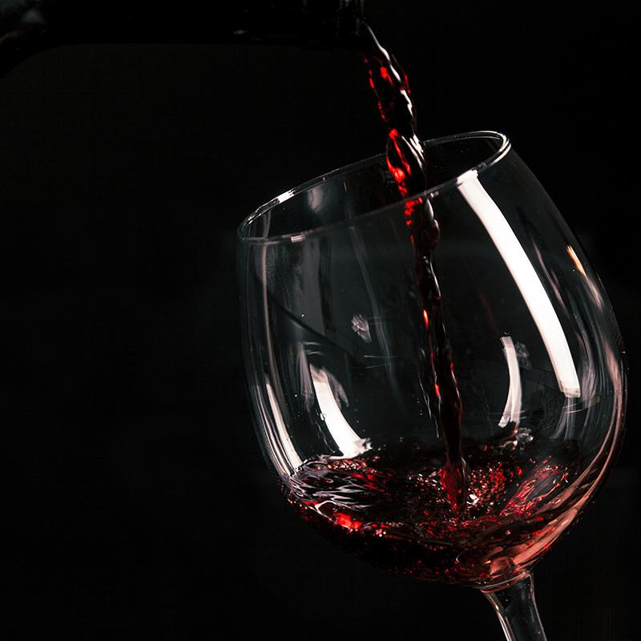
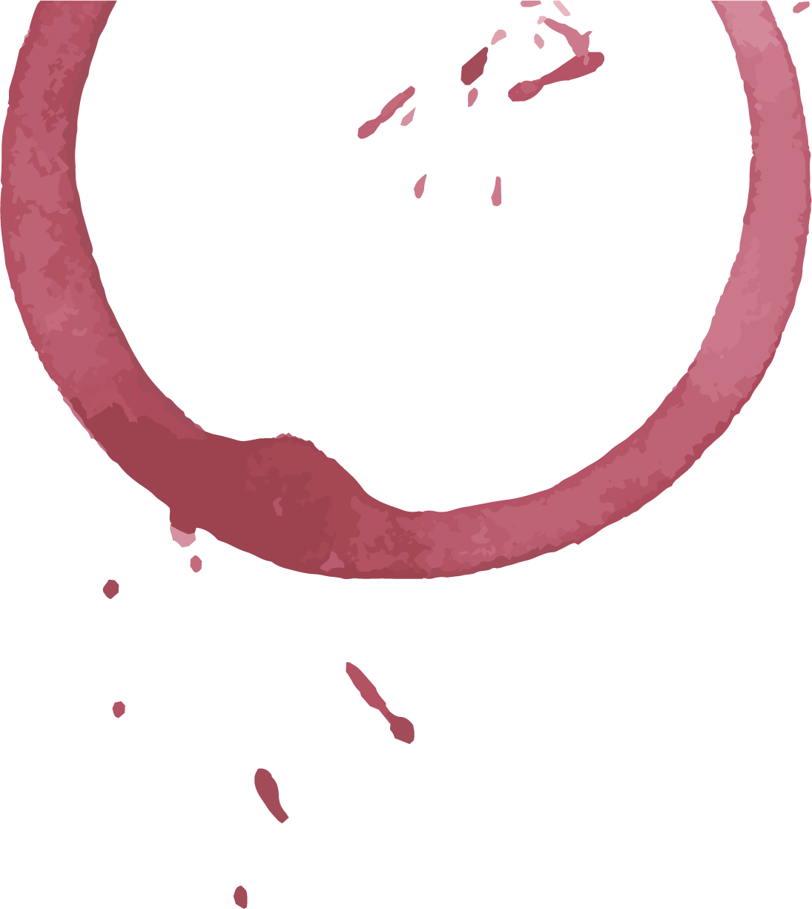
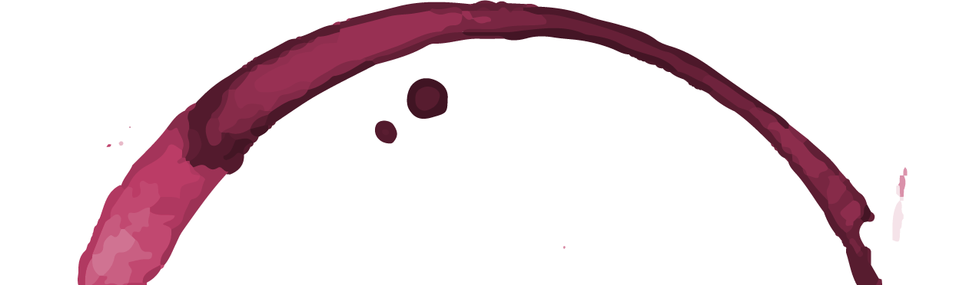
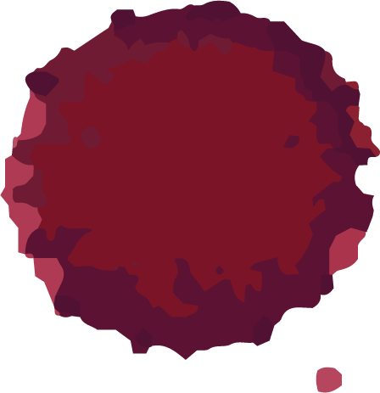
REFERENCES
Domine, A. (2008). Wine, pp. 402-411, Ullmann Publishing, ISBN 978-3-8331-4611-4
Mower, L. (2019, January 29). A Beginner’s Guide to Chianti and Chianti Classico. Wine Enthusiast. https://www.winemag.com/2019/01/29/beginners-guide-chianti-chianti-classico/
Rohrbaugh, J. (2021, March 25). Chianti Wine: The Pride of Tuscany. Wine Folly. https://winefolly.com/deep-dive/chianti-wine-tuscany/
Wine and Other Stories. (2020, January 24). The Chianti Series - Part 1: The history of Chianti ~. https://wineandotherstories.com/the-chianti-series-p1-the-history-of-chianti/
Wine and Travel Italy. (2021, June 3). The History of Chianti Classico. https://wineandtravelitaly.com/history-chianti-classico/

